Slide 1








DISA SIPR
DISA SIPR
NEC / RCC
NEC / RCC
TUNNEL
TUNNEL
DISA TRANSPORT INFRASTRUCTURE
UNIT CLASSIFIED
NETWORK
UNIT CLASSIFIED
NETWORK

Slide 2
UNIT COLORLESS
EDGE
(LAST LEG CIRCUIT)
GAIT
GLOBAL AGILE
INTEGRATE TRANSPORT
UNIT COLORLESS
EDGE
(LAST LEG CIRCUIT)
GAIT CORE
ROUTERS
GAIT CORE
ROUTERS
GAIT EDGE
ROUTER
(GAIT PoP)
GAIT EDGE
ROUTER
(GAIT PoP)
DISA TRANSPORT INFRASTRUCTURE
UNIT CLASSIFIED
NETWORK
TUNNEL
UNIT CLASSIFIED
NETWORK

Slide 3

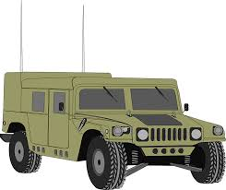

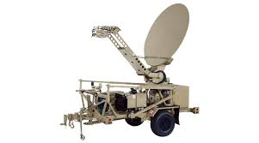




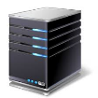
UNIT IN THE FIELD
UNIT
COLORLESS
JNN MAIN
RHN SIPR
RHN
COLORLESS
RCC
FIREWALL
GLOBAL
SIPR
TACTICAL SIPR IN THE FIELD
TACTICAL IP SPACE
TEMPORARY
NETWORK
ADVERTISEMENT
RCC
FIREWALL
NEC
CT VLAN
INSTALLATION NIPR
JNN TAC (OR CPN)
NEC / ICAN
NIPR SWITCH
NEC / ICAN
NIPR SWITCH
NEC / ICAN
SIPR TLA
IAADS SIPR IN GARRISON

Slide 4
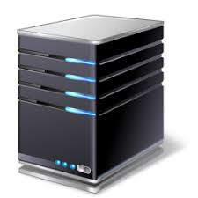
UNIT IN THE FIELD
UNIT
COLORLESS
RHN SIPR
RHN
COLORLESS
RCC
FIREWALL
TACTICAL SIPR IN THE FIELD
GLOBAL
SIPR
TACTICAL IP SPACE
PERMANENT
NETWORK
ADVERTISEMENT
IAADS SIPR IN
GARRISON
RCC
FIREWALL
NEC
CT VLAN
INSTALLATION NIPR
GLOBAL SIPR
WEB
RESOURCES
(AKO-S, SIPR WEBMAIL
JIST, INTELINK)
NEC / ICAN
NIPR SWITCH
NEC / ICAN
NIPR SWITCH
NEC / ICAN
SIPR TLA
IAADS SIPR IN
GARRISON

Slide 5



UNIT IN THE FIELD
UNIT
COLORLESS
GLOBAL
SIPR
RHN
COLORLESS
RHN SIPR
RCC
FIREWALL
RHN
GAIT
PoP
TACTICAL SIPR IN THE FIELD
TACTICAL IP SPACE
PERMANENT
NETWORK
ADVERTISEMENT
GAIT
TRANSPORT
GLOBAL SIPR
WEB
RESOURCES
(AKO-S, SIPR WEBMAIL
JIST, INTELINK)
IAADS SIPR IN
GARRISON
BGN
NOC
MISSION
PARTNERS
OTHER RHNs
UNIT
GAIT
LAST-LEG
CIRCUIT
(COLORLESS)
INSTALLATION
(LOCAL)
GAIT
PoP
RCC
FIREWALL
IAADS SIPR IN
GARRISON
NEC / ICAN
SIPR TLA

Slide 6



UNIT IN THE FIELD
UNIT
COLORLESS
GLOBAL
SIPR
RHN
COLORLESS
RHN SIPR
RCC
FIREWALL
RHN
GAIT
PoP
TACTICAL SIPR IN THE FIELD
TACTICAL IP SPACE
PERMANENT
NETWORK
ADVERTISEMENT
GAIT
TRANSPORT
BGN
NOC
GLOBAL SIPR
WEB
RESOURCES
(AKO-S, SIPR WEBMAIL
JIST, INTELINK)
MISSION
PARTNERS
CX-J
TAC SIPR
OTHER RHNs
INSTALLATION
(LOCAL)
GAIT
PoP
RCC
FIREWALL
UNIT
GAIT
LAST-LEG
CIRCUIT
(COLORLESS)
YAMA
SAKURA
UFG
CX-K
NEC / ICAN
SIPR TLA

